Slide 1



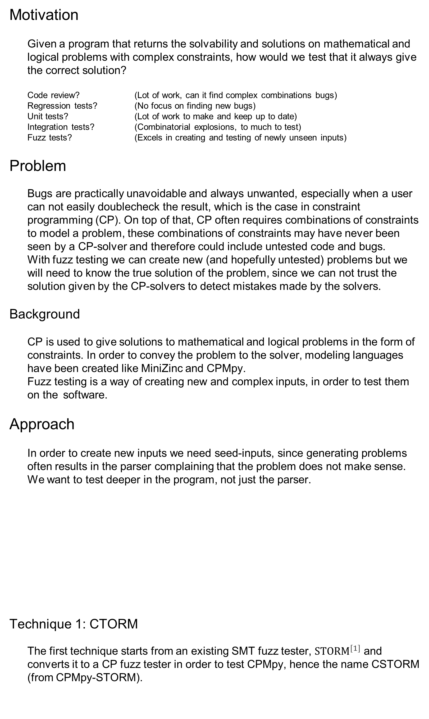
Fuzz Testing of Constraint Programming
ing. Ruben Kindt Prof. dr. T. Guns, Ir. I. Bleukx
Motivation
Given a program that returns the solvability and solutions on mathematical and logical problems with complex constraints, how would we test that it always give the correct solution?
Code review? (Lot of work, can it find complex combinations bugs)
Regression tests? (No focus on finding new bugs)
Unit tests? (Lot of work to make and keep up to date)
Integration tests? (Combinatorial explosions, to much to test)
Fuzz tests? (Excels in creating and testing of newly unseen inputs)
Problem
Bugs are practically unavoidable and always unwanted, especially when a user can not easily doublecheck the result, which is the case in constraint programming (CP). On top of that, CP often requires combinations of constraints to model a problem, these combinations of constraints may have never been seen by a CP-solver and therefore could include untested code and bugs.
With fuzz testing we can create new (and hopefully untested) problems but we will need to know the true solution of the problem, since we can not trust the solution given by the CP-solvers to detect mistakes made by the solvers.
Background
CP is used to give solutions to mathematical and logical problems in the form of constraints. In order to convey the problem to the solver, modeling languages have been created like MiniZinc and CPMpy.
Fuzz testing is a way of creating new and complex inputs, in order to test them on the software.
Approach
In order to create new inputs we need seed-inputs, since generating problems often results in the parser complaining that the problem does not make sense. We want to test deeper in the program, not just the parser.
Technique 1: CTORM
The first technique starts from an existing SMT fuzz tester, ${STORM}^{[1]}$ and converts it to a CP fuzz tester in order to test CPMpy, hence the name CSTORM (from CPMpy-STORM).
Technique 2: Metamorphic testing
The second technique takes the constraints of the problem and turns them into equivalent but complex constraints. For example, a ‘variable1 == 4’ will be changed into ‘(variable1 >= 4) and (variable1 =< 4)’
In total 30 metamorphic transformations were implemented and can be reformed on already transformed constraints to built even more complex ones.
Technique 3: Differential testing
The last technique moves away from the fuzz testing world since no changes were made to the seed inputs. Instead of changing constraints, here the advantage of having multiple solvers was used.
Results
The table below shows the found bugs, around two-thirds of the bugs were the result of a crash, the others are more critical and result in a wrong output. The bugs found surrounding the OR-Tools solver were also found in the Gurobi solver this due to both solver sharing a substantial amount of code in the transformations of CPMpy. Of the techniques used CTORM found 10 bugs, metamorphic testing found the most bug at 13 and differential testing found 11 out of 19 total found bugs.
Conclusion
None of the techniques got a perfect score, meaning that when looking for all bugs a combination of tools will be needed. As in the real world there is no silver bullet on bug catching. This does not take away the utility of each of the techniques used. Metamorphic testing can be used to guide the fuzz tester on a specific code area by choosing which metamorphic transformations used and differential testing is easy to set up and to test between similar solvers.
Future Work
Most interesting is fuzz testing the configuration space of the solvers on top of fuzz testing the input, as discussed by Peisen Yao et al. [2]. For example, there could be bugs that only occur when certain optimizations are turned on or off like: dynamic symmetry breaking or others.
CP seeds
Transform constraints to complex but equivalent
constraints
Solve new CP problem
Solve original CP seed
Compare
expected to gotten result
crashed?
hanging?
Bugs
CP seeds
Solve by solver 1
Compare
solution 1 to solution 2 and amount of solutions
crashed?
hanging?
Solve by solver 2
Bugs
CPMpy example problems
with other imports, multiple models per file
Temporary modified CPMpy
CP Seed files variables, constraints, objective function
Location of bug within CPMpy | Crash, wrongly (un)sat or wrong nr of Solutions | solver independent Bug | OR-Tools solver | Gurobi solver | MiniZinc subsolvers | Pysat subsolvers
Model | crash | Diff
Model | UNSATISFIABLE | Meta
Model | UNSATISFIABLE | CTORM, Meta
Solver | crash |  |  |  | CTORM, Meta, Diff
Solver Interface | crash |  |  | CTORM, Diff
Solver Interface | crash |  |  |  |  | Diff
Solver Interface | crash | Meta, Diff
Solver Interface | Wrong Nr of sol |  |  | Diff
Solver Interface | crash |  |  |  | CTORM, Meta, Diff
Solver Interface | crash |  |  | CTORM, Meta, Diff
Solver Interface | crash |  |  | CTORM, Diff
Solver Interface | crash |  |  |  | Meta
Transformation | UNSATISFIABLE |  | CTORM | CTORM
Transformation | crash |  | CTORM, Meta | CTORM, Meta
Transformation | crash | Meta
Transformation | crash |  |  |  | Meta
Transformation | crash |  |  |  | Meta, Diff
Transformation | UNSATISFIABLE |  |  | CTORM, Meta, Diff
Transformation | (UN)SATISFIABLE |  | CTORM, Meta | CTORM, Meta
$$STORM$$
Solve original SMT seed
Label constraints True/False
Create new
combinations
Solve new SMT problem
SMT seeds
Compare
expected to gotten result
Bugs
CTORM
Solve original CP seed
Label constraints True/False
Create new
combinations
Solve new CP problem
CP seeds
Compare
expected to gotten result
crashed?
hanging?
Bugs
Acknowledgements
Firstly, I would like to thank professor dr. Tias Guns for the guidance and the proposal of this fascinating topic, ir. Ignace Bleukx for answering many questions, intensive thesis meetings, proofreading and the cleverness for coming up with the name of CTORM, dr. ir. Jo Devriendt for finding bugs within our bug finder, the rest of the CPMpy-team, Hakan Kjellerstrand for publishing a significant number of examples which we used as seeds, friends for proofreading even all the way back from industrial engineering on campus De Nayer like ing. Simon Vandevelde. Finally, I would like to thank my family for the support during my further studies.
- Ruben Kindt
References
[1] Muhammad Numair Mansur et al. “Detecting critical bugs in SMT solvers using blackbox mutational fuzzing”. In: Proceedings of the 28th ACM Joint Meeting on European Software Engineering Conference and Symposium on the Foundations of Software Engineering. 2020, pp. 701–712.
[2] Peisen Yao et al. “Fuzzing smt solvers via two-dimensional input space exploration”. In: Proceedings of the 30th ACM SIGSOFT International Symposium on Software Testing and Analysis. 2021, pp. 322–335.

